Slide 1
Introduction to web tools for protein structure classification
Basic concepts | 15 min
- Hierarchical structure of proteins
- Globular and elongated domains
- Intrinsically disordered proteins and regions
Introduction to data file formats: PDB and mmCIF Overall quality of the structure
Structural analysis | 20 min
-Search for structures in the Protein Data Bank
-Retrieving of atomic coordinate files
Q&A | 5 min

Slide 2
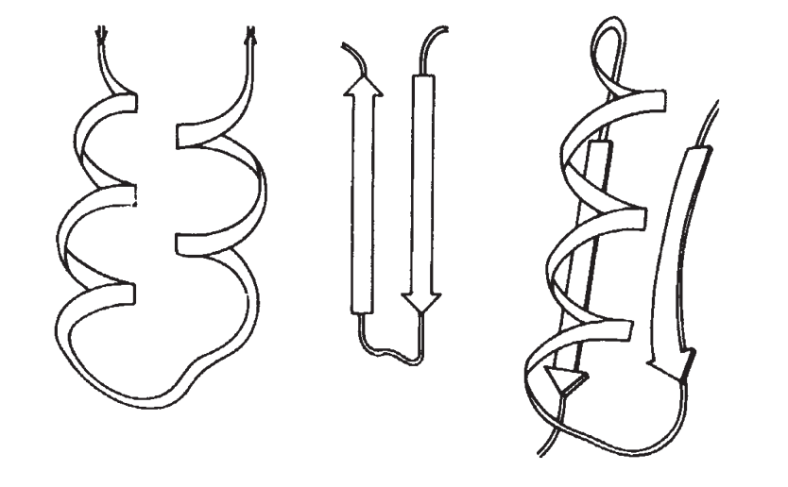
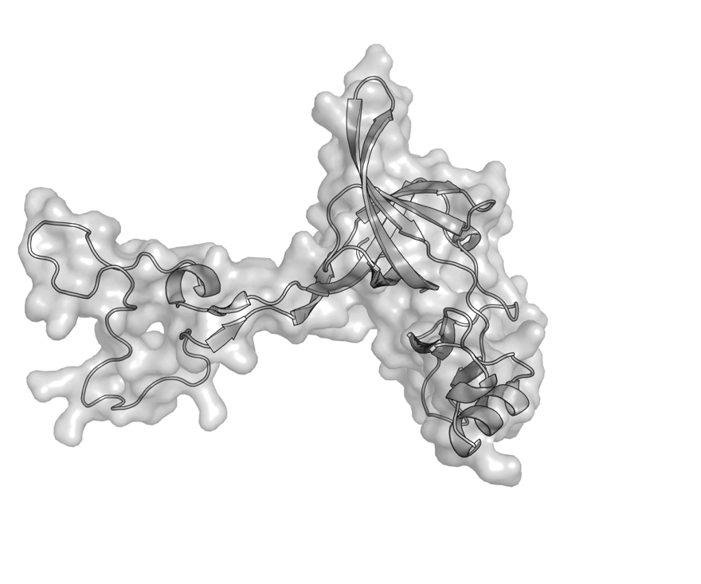
From macroscopic traits to proteins
Primary structure
Sequential arrangement of proteinogenic amino acids in a polypeptide chain.
Secondary structure
Local spatial arrangement of the polypeptide backbone.
Two regular arrangements:
Helices
Beta strands
Tertiary structure
Overall spatial arrangement of atoms in a protein.
>uL03b_511145_ECOLI
MIGLVGKKVGMTRIFTEDGVSIPVTVIEVEANRVTQVKDLANDGYRAIQ
VTTGAKKANRVTKPEAGHFAKAGVEAGRGLWEFRLAEGEEFTVGQSISV
ELFADVKKVDVTGTSKGKGFAGTVKRWNFRTQDATHGNSLSHRVPGSIG
QNQTPGKVFKGKKMAGQMGNERVTVQSLDVVRVDAERNLLLVKGAVPGA
TGSDLIVKPAVKA

Slide 3
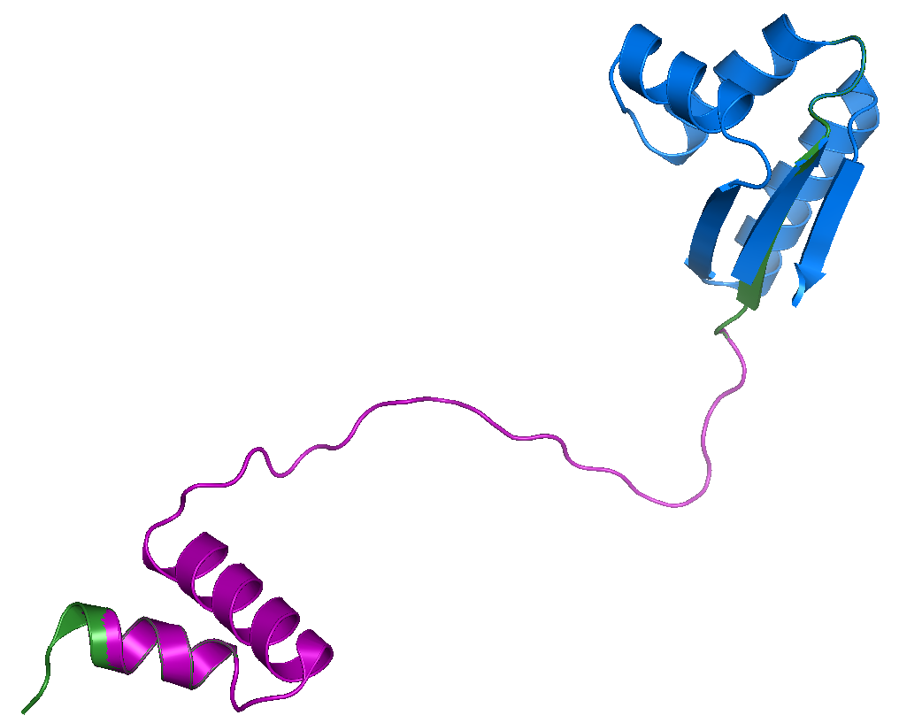
Protein domains
Proteins are composed of domains, autonomous structural and/or functional units in a protein, therefore they can acquire a well-defined structure (fold) and function on its own.
Tompa P. Structure and Function of Intrinsically Disordered Proteins. CRC Press, Boca Raton. 2010. pp:10-11.
Ribosomal_L12_N
Ribosomal_L12
PDB ID: 1RQU. Ribosomal protein L7 from Escherichia coli.
Bocharov E, Sobol A, Pavlov K, Korzhnev D, Jaravine V, Gudkov A, Arseniev A. J Biol Chem. 2004. 279: 17697-17706. DOI: 10.1074/jbc.M313384200

Slide 4
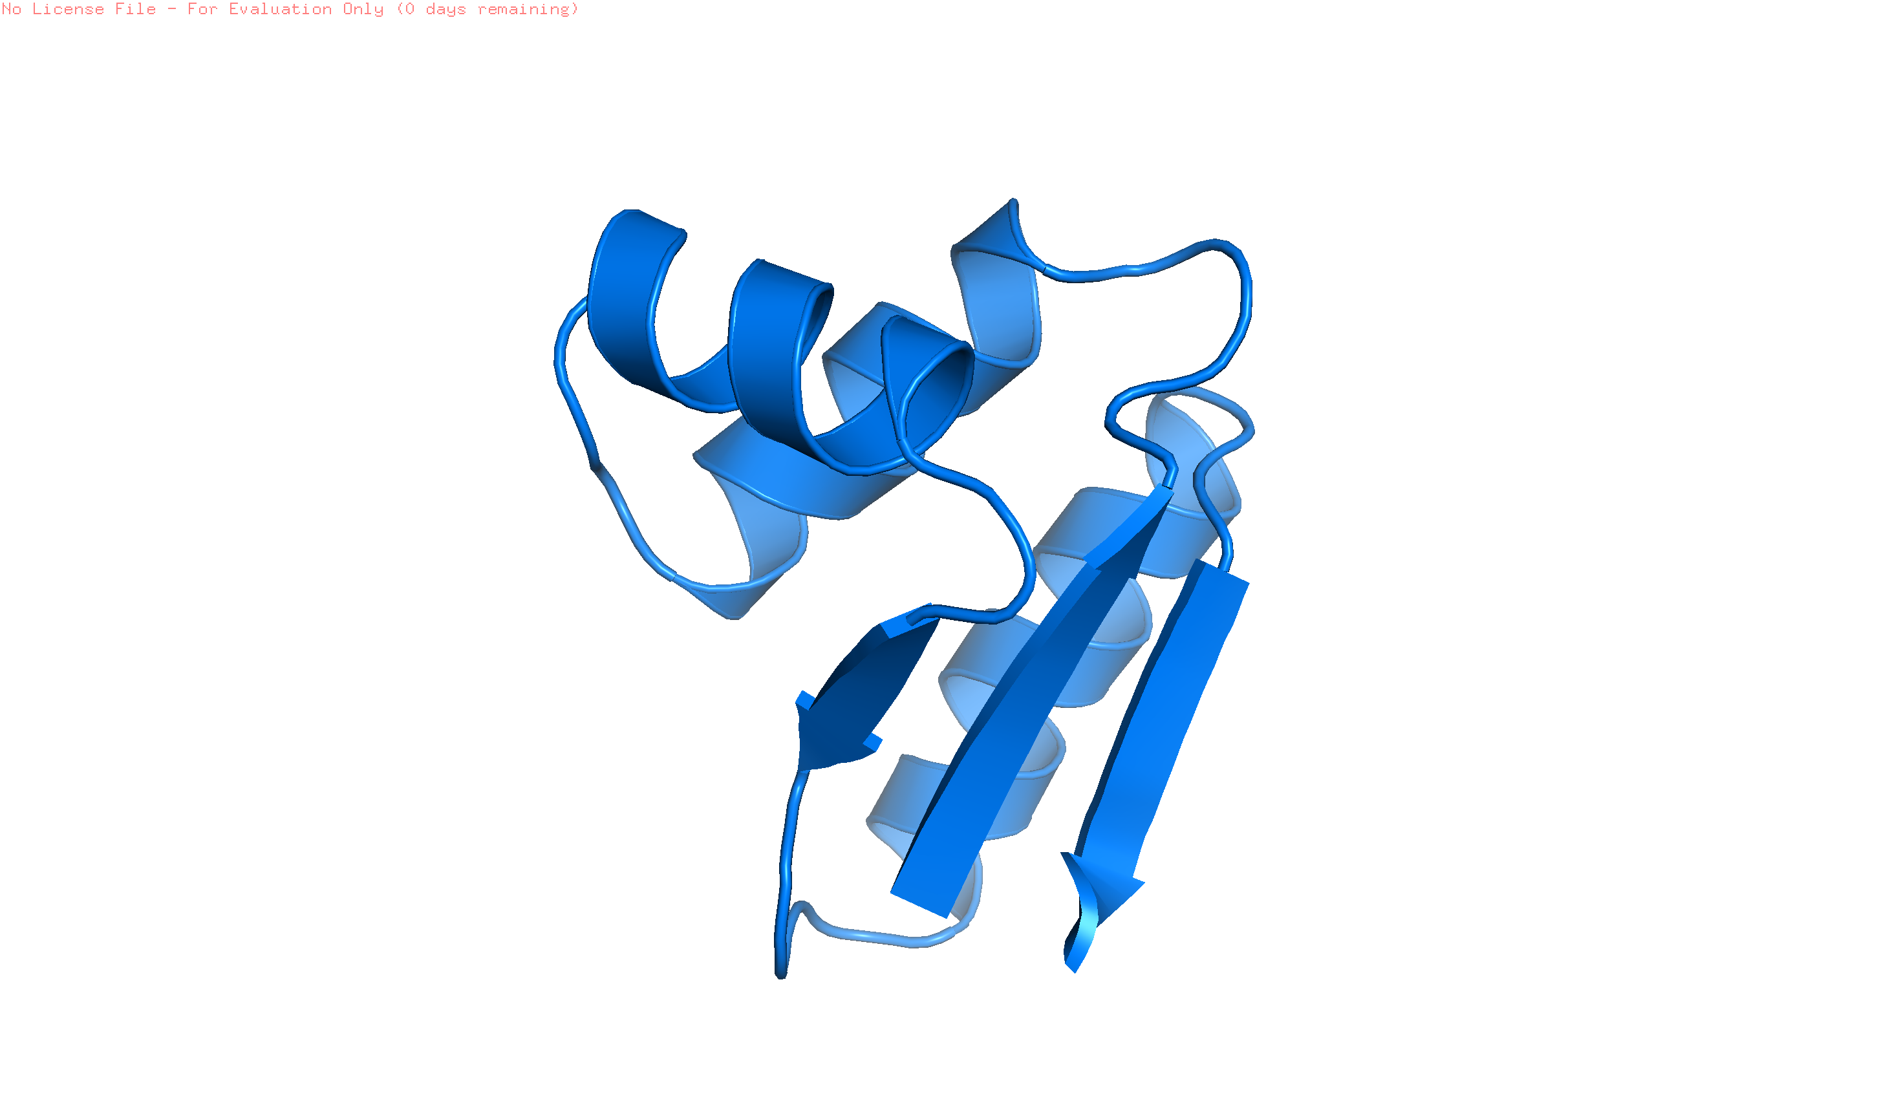
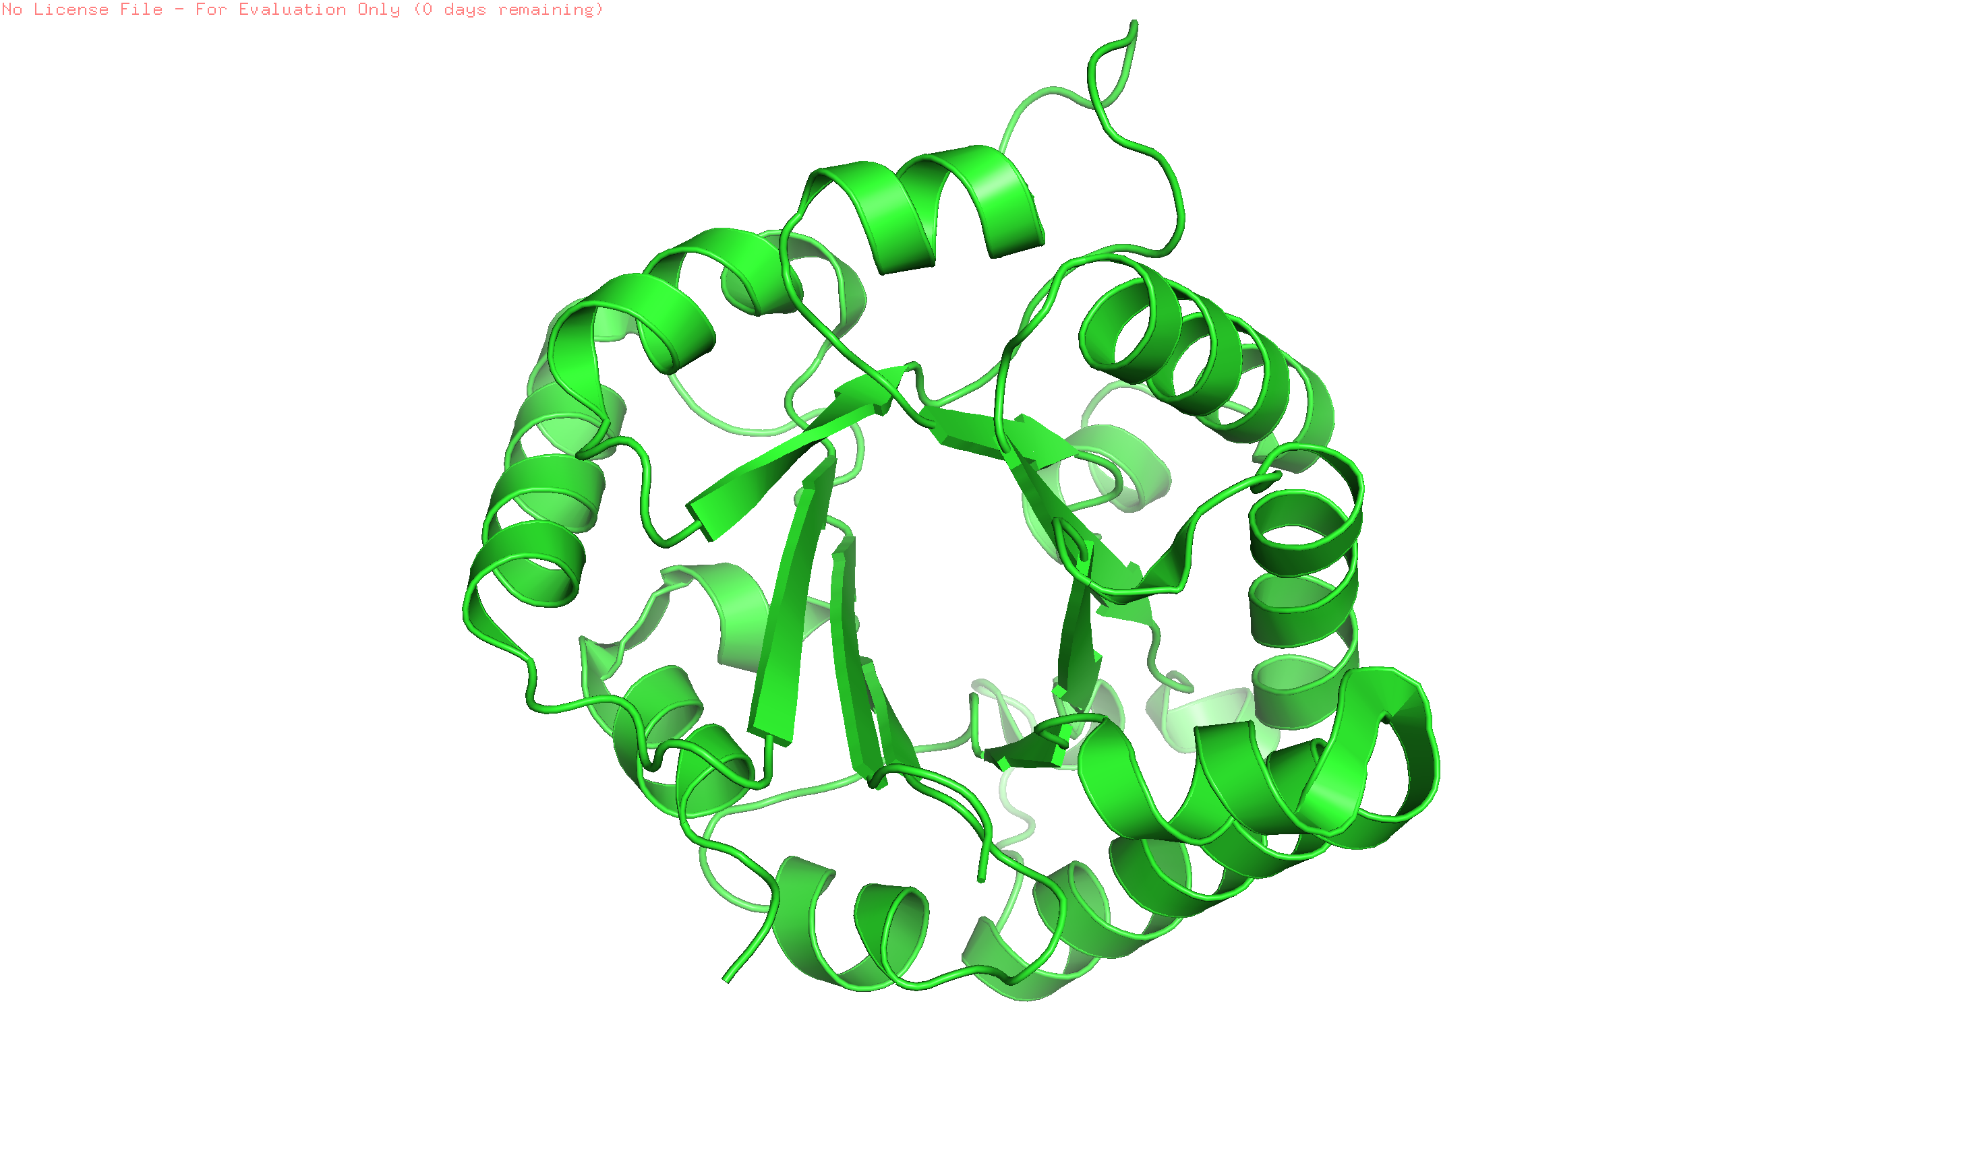

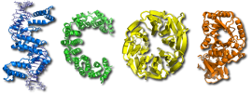
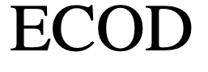
Globular domains
Their polypeptide chains fold into a compact globule, promoted by the presence of packed hydrophobic amino acids in the interior, leading to a rounded or globular shape.
Tompa P. Structure and Function of Intrinsically Disordered Proteins. CRC Press, Boca Raton. 2010. pp:10-11.
Hierarchical classification of protein domains databases
doi: 10.1093/nar/gky1097
doi.org/10.1093/nar/gkz1064
doi.org/10.1371/journal.pcbi.1003926
PDB ID: 1R2T Triose-phosphate isomerase (TIM). Aparicio R, Ferreira S, Polikarpov I. J Mol Biol. 2003. 334: 1023-1041. DOI: 10.1016/j.jmb.2003.10.022
PDB ID: 1RQU. Ribosomal protein L7.
Bocharov E, Sobol A, Pavlov K, Korzhnev D, Jaravine V, Gudkov A, Arseniev A. J Biol Chem. 2004. 279: 17697-17706. DOI: 10.1074/jbc.M313384200

Slide 5
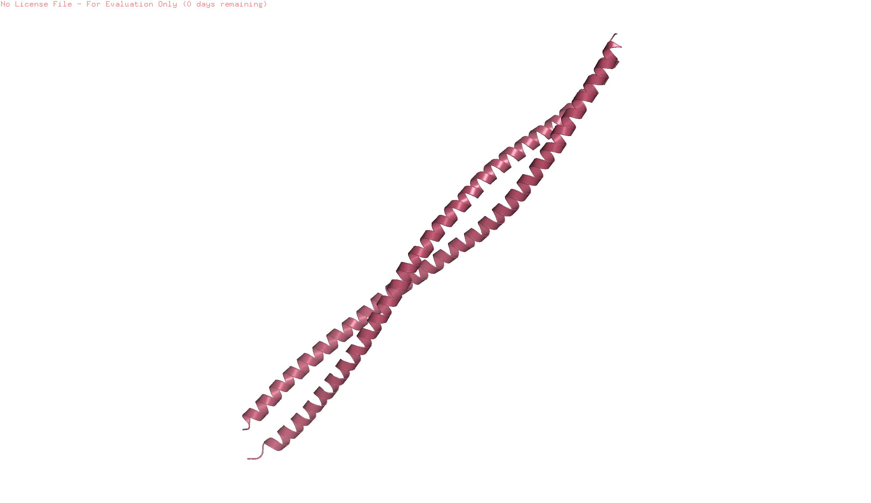
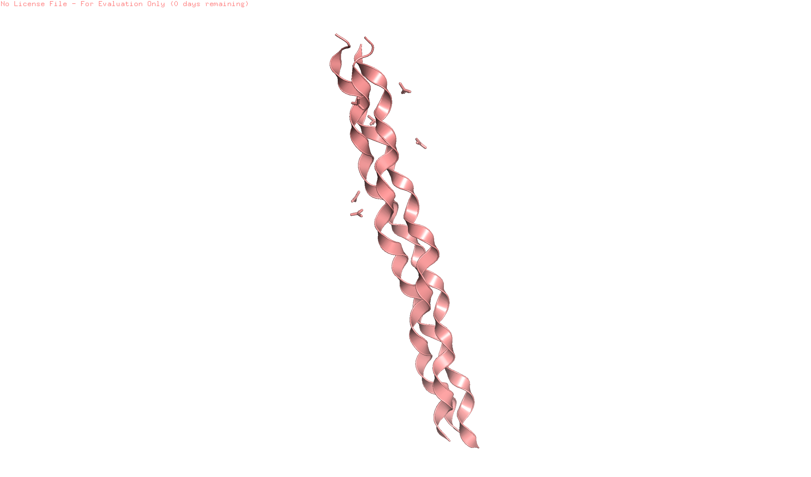
Elongated domains
Domains lack the rounded shape of the globular units, and instead, present an elongated three-dimensional structure.
Tompa P. Structure and Function of Intrinsically Disordered Proteins. CRC Press, Boca Raton. 2010. pp:10-11.
Hierarchical classification of protein domains databases
doi: 10.1093/nar/gky1097
doi.org/10.1093/nar/gkz1064
doi.org/10.1371/journal.pcbi.1003926
PDB ID: 6EC0. Keratin 1. Eldirany S, Ho M, Hinbest A, Lomakin I, Bunick C.
EMBO J. 2019. 38.
PDB ID: 1CAG. Collagen-like peptide. Bella, J., Eaton, M., Brodsky, B., Berman, H.M.
.Science.1994. 266: 75-81.

Slide 6
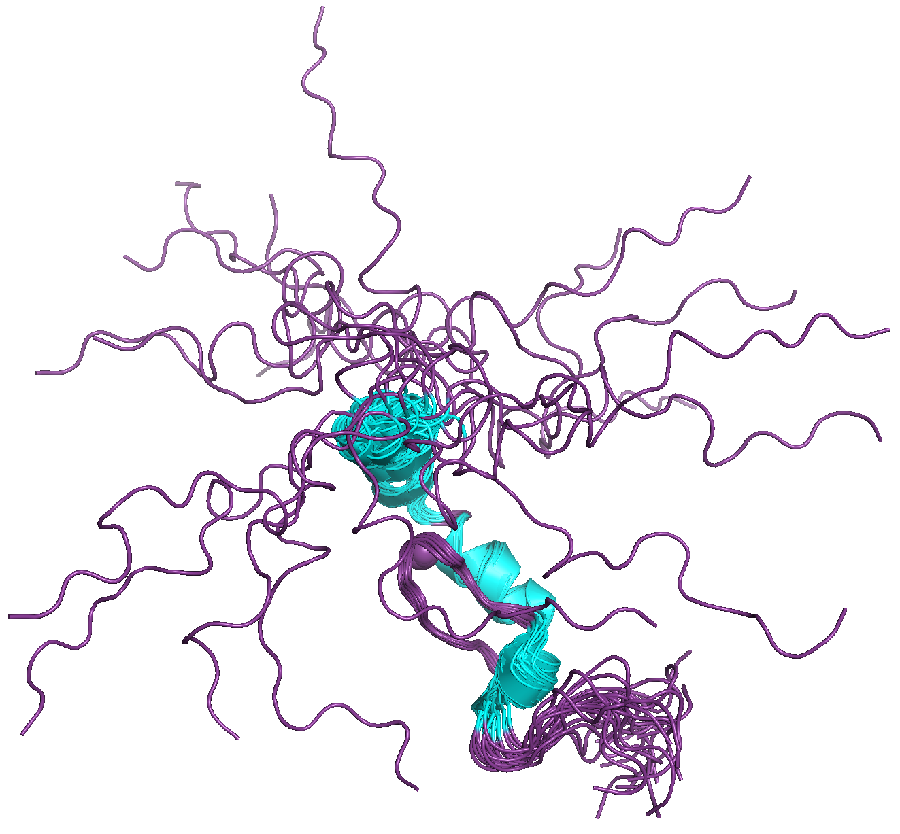
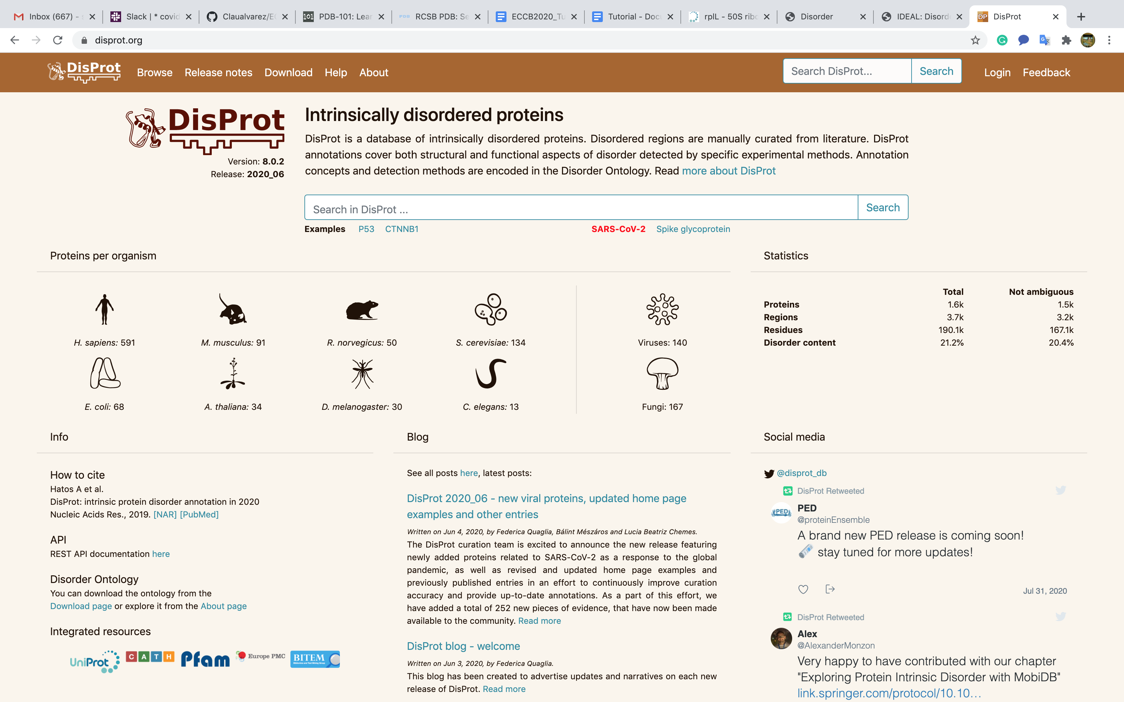
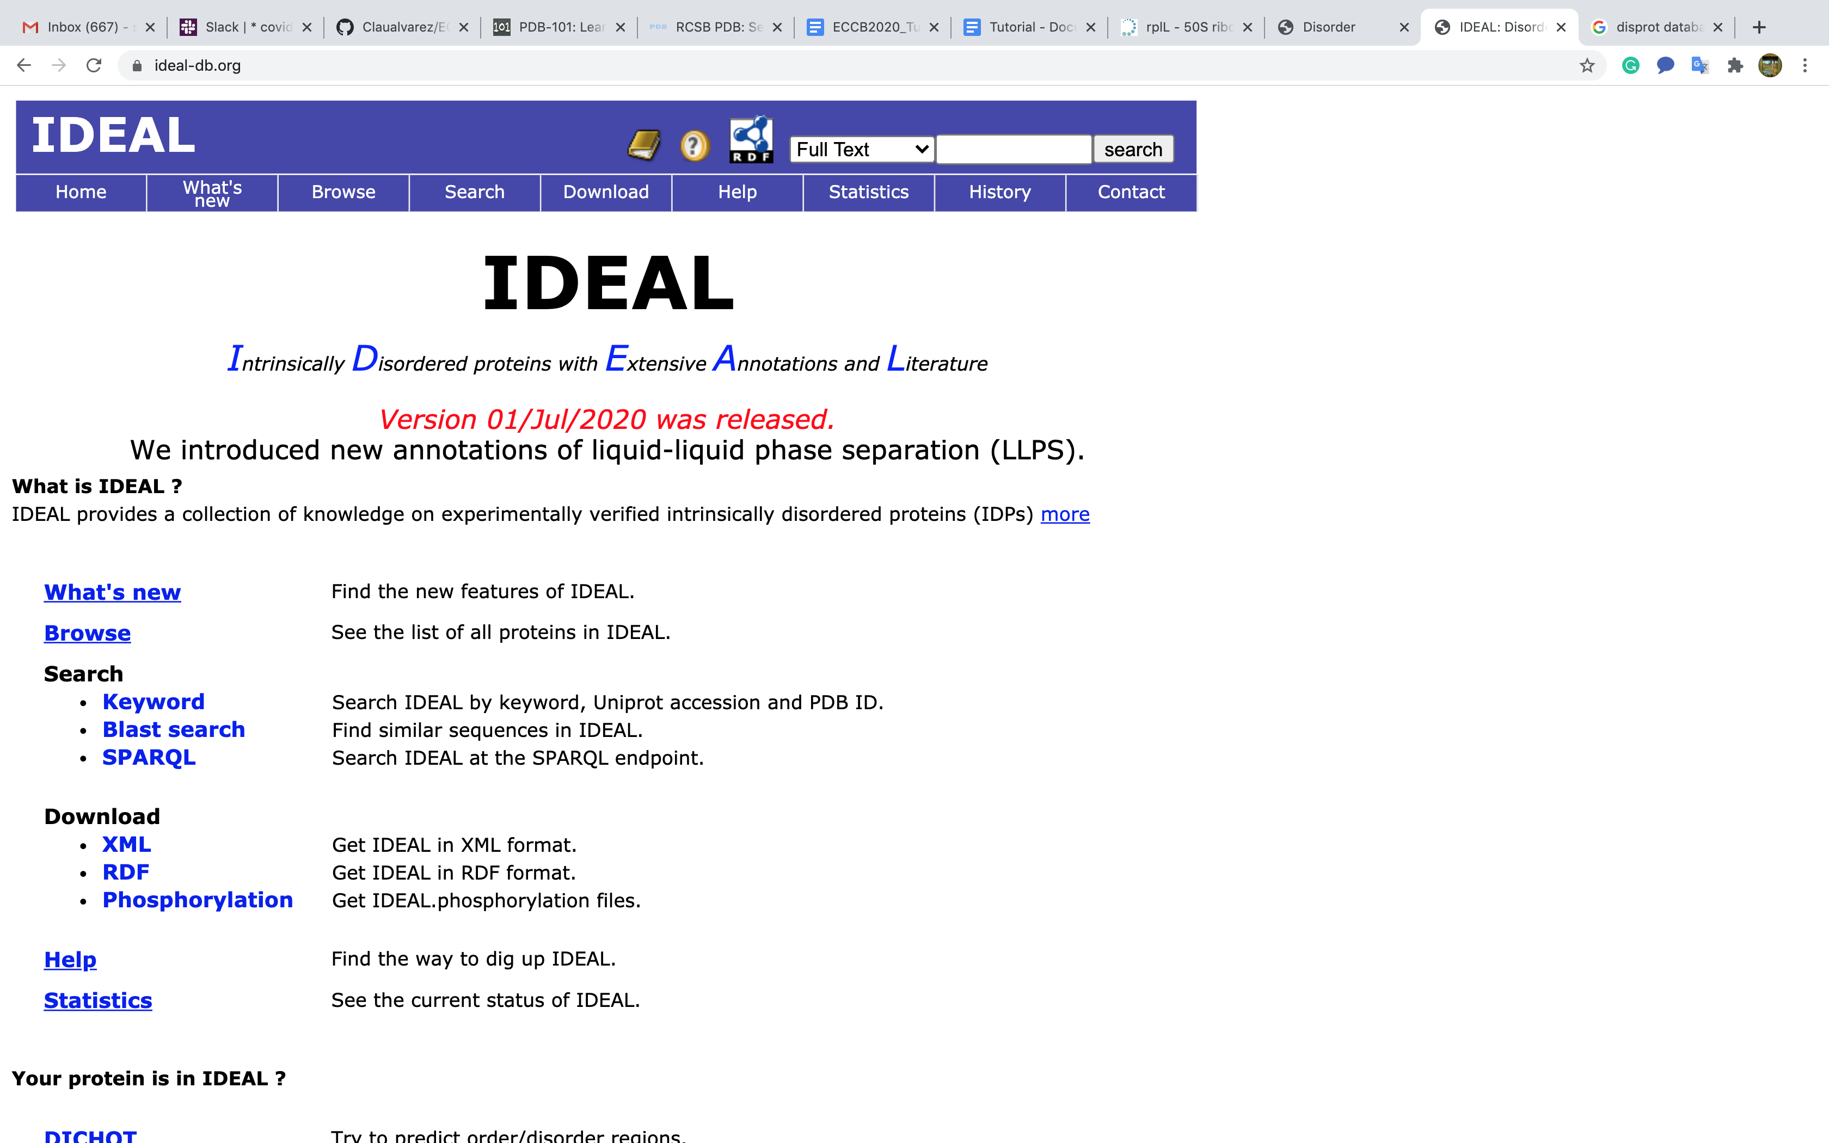
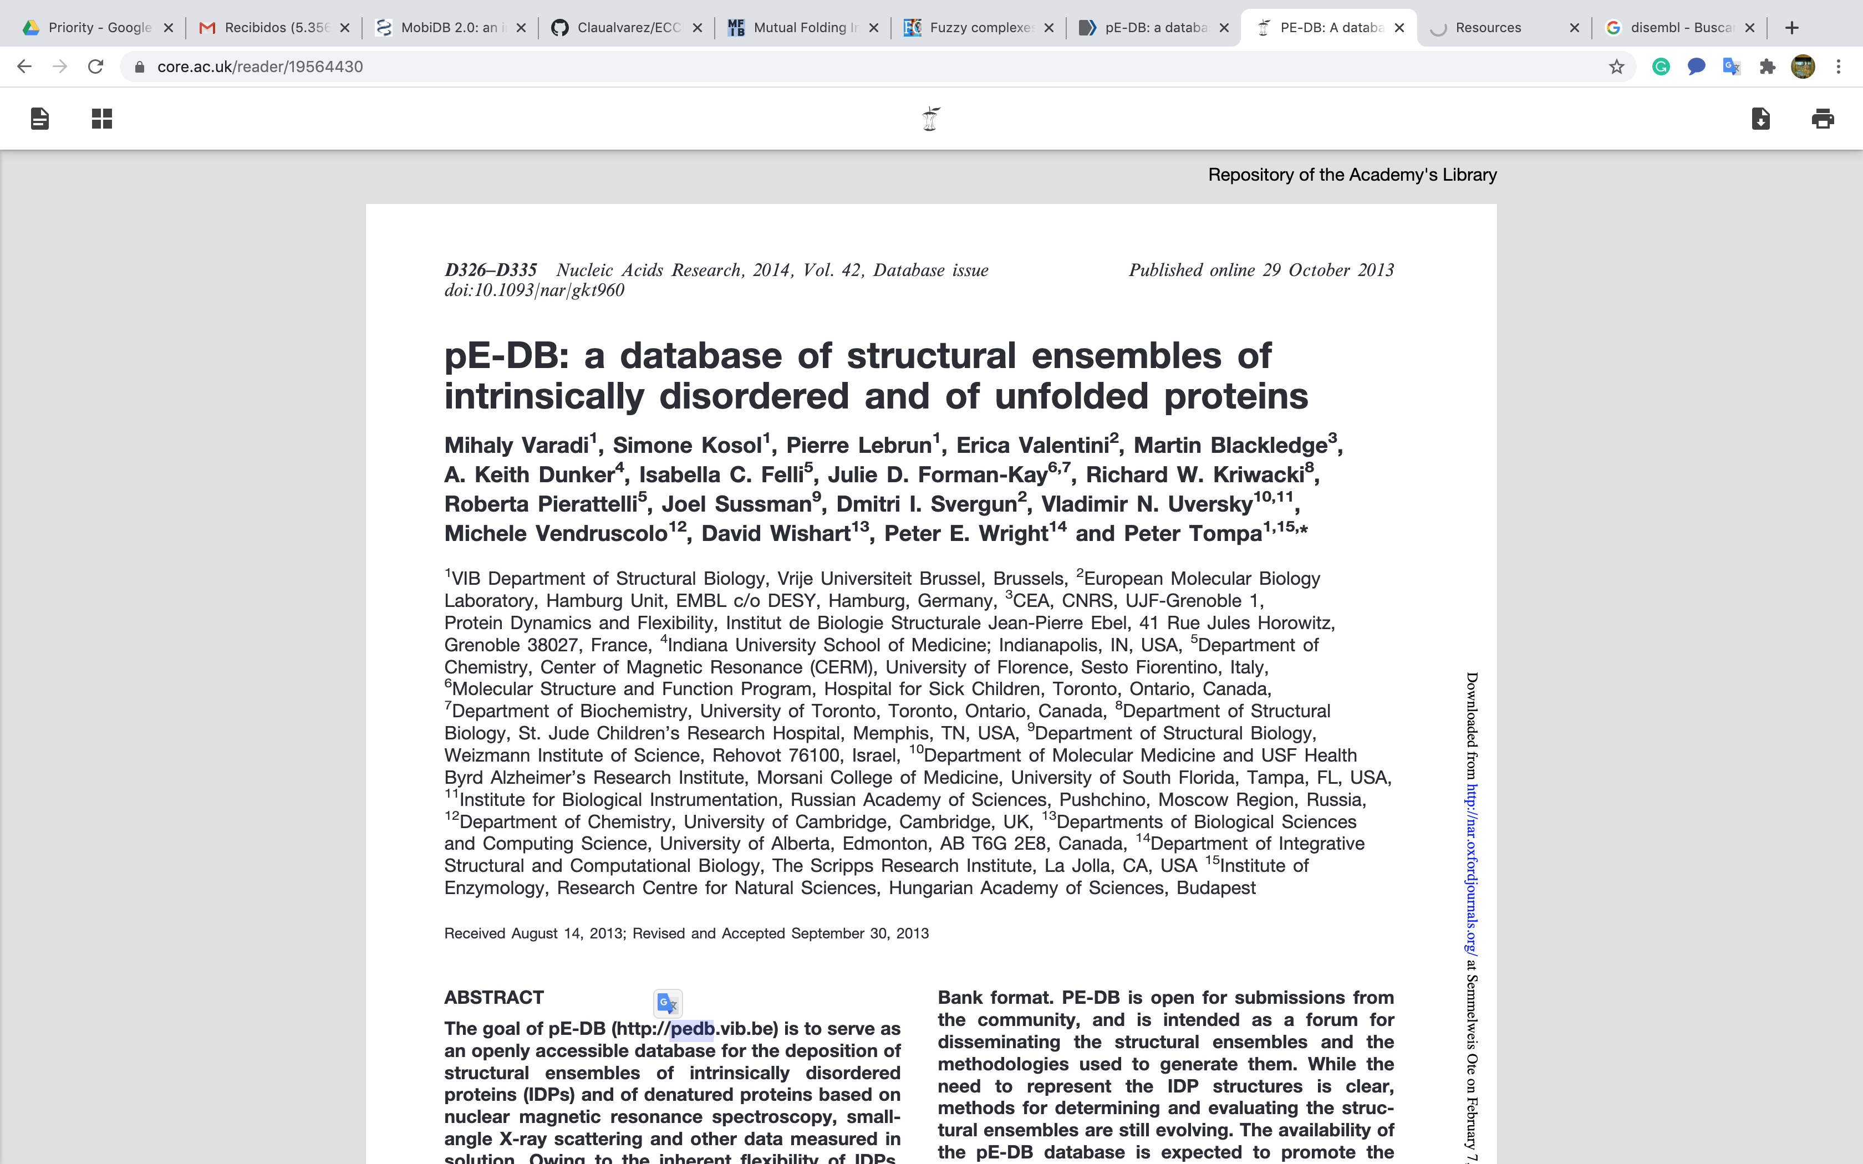
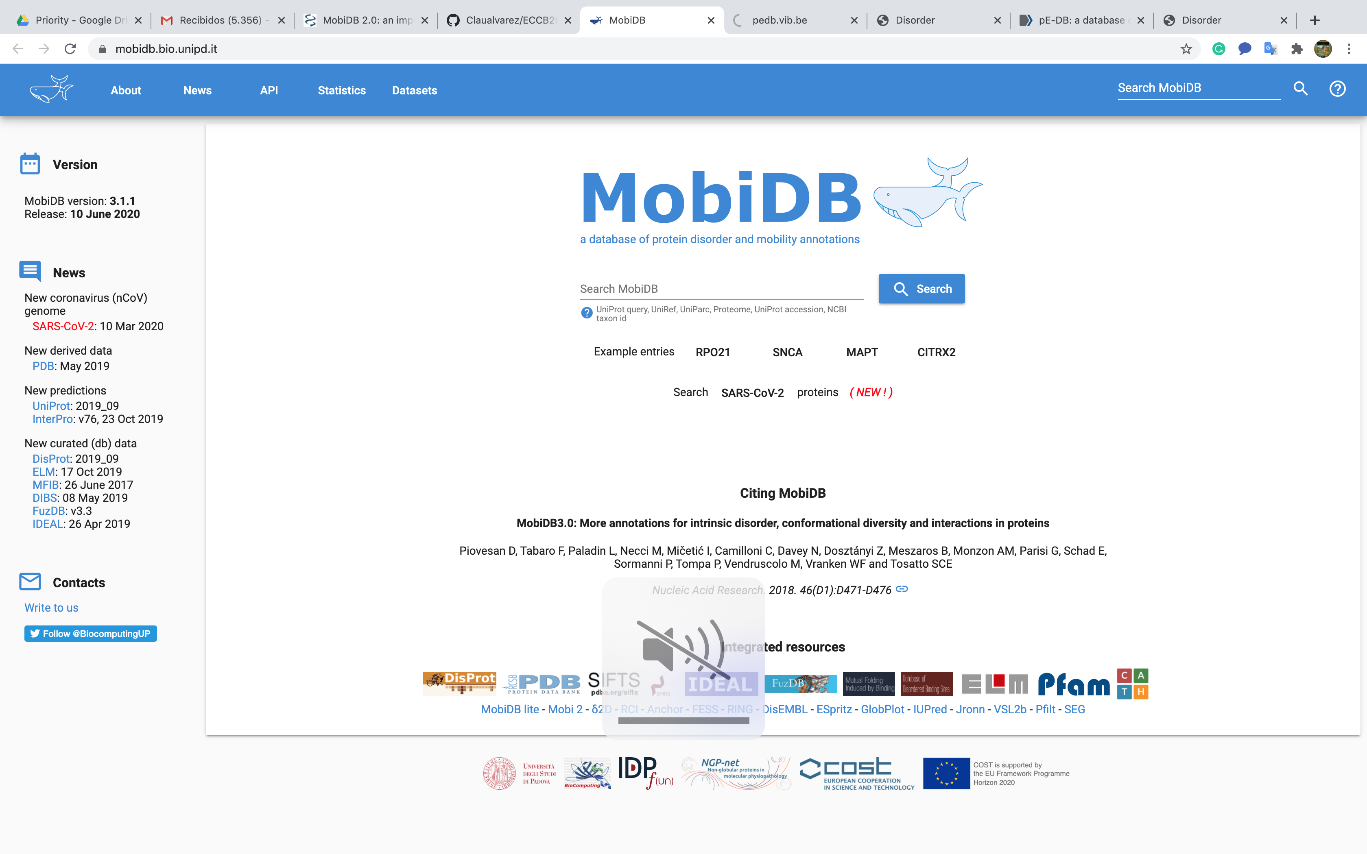
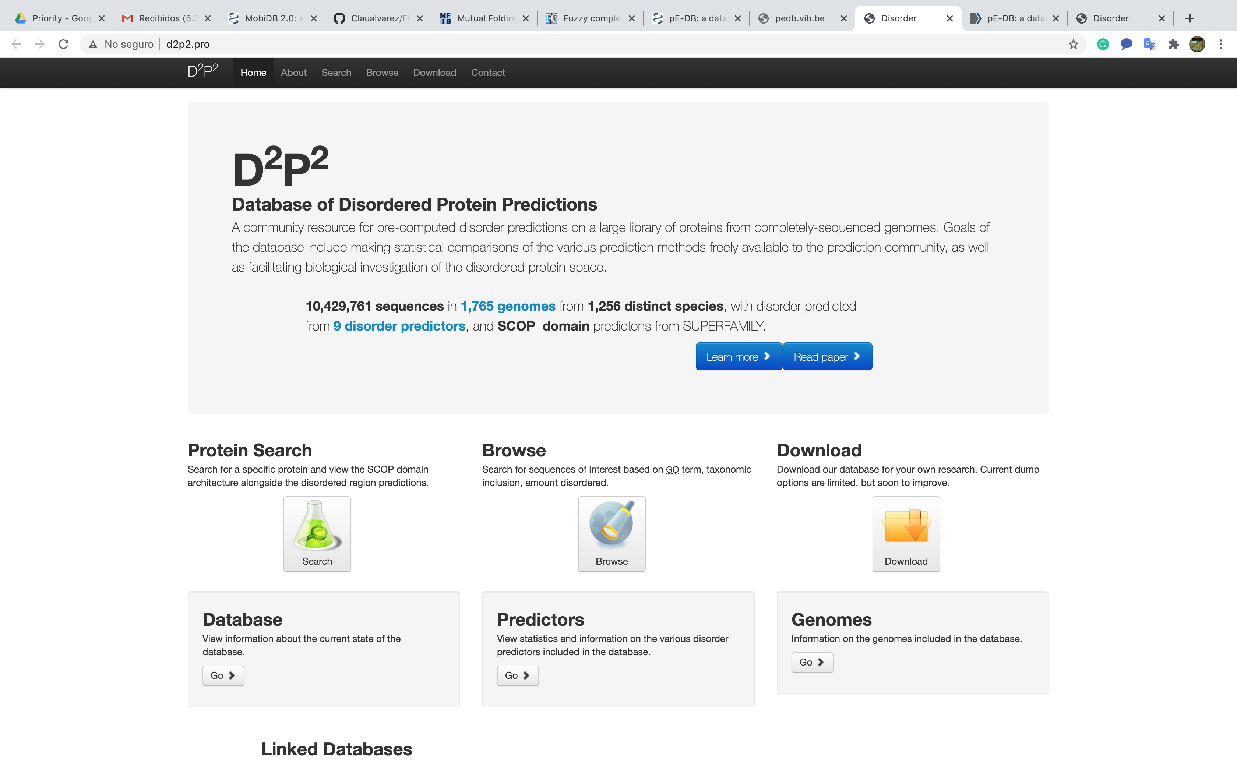
Intrinsically disordered proteins and regions
Intrinsically disordered proteins (IDPs) or regions (IDRs) are characterized by the lack of a unique 3-D structure in their functional states. This flexible proteins exist as a heterogeneous, highly dynamic set of conformers.
Hierarchical classification of disordered proteins domains
Protein disorder databases
van der Lee et al. Classification of Intrinsically Disordered Regions and Proteins. Chem. Rev. 2014. 114: 6589−6631. doi: 10.1021/cr400525m.
Uversky V. Introduction to Intrinsically Disordered Proteins (IDPs). Chem. Rev. 2014. 114:6557−6560. doi.org/10.1021/cr500288y.
doi:10.1093/nar/gkz975
doi: 10.1093/nar/gkt1010
doi:10.1093/nar/gkz1064
doi:10.1093/nar/gkt960
doi:10.1093/nar/gkx1071
doi:10.1093/nar/gks1226
PDB ID: 1ZR9. Human C2H2-type Zinc Finger Protein. Hayes P, Lytle B, Volkman B, Peterson F. The solution structure of ZNF593 from Homo sapiens reveals a zinc finger in a predominantly unstructured protein. Protein Sci. 2008. 17 571-6. doi:10.1110/ps.073290408.

Slide 7
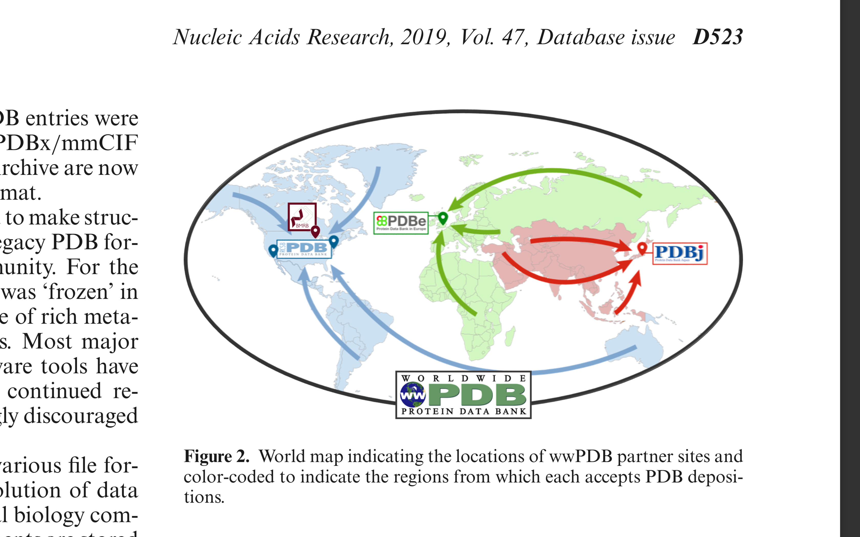
Protein Data Bank (PDB)
Nucleic Acids Research, 2019, Vol. 47, Database issue . doi: 10.1093/nar/gky949.

Slide 8
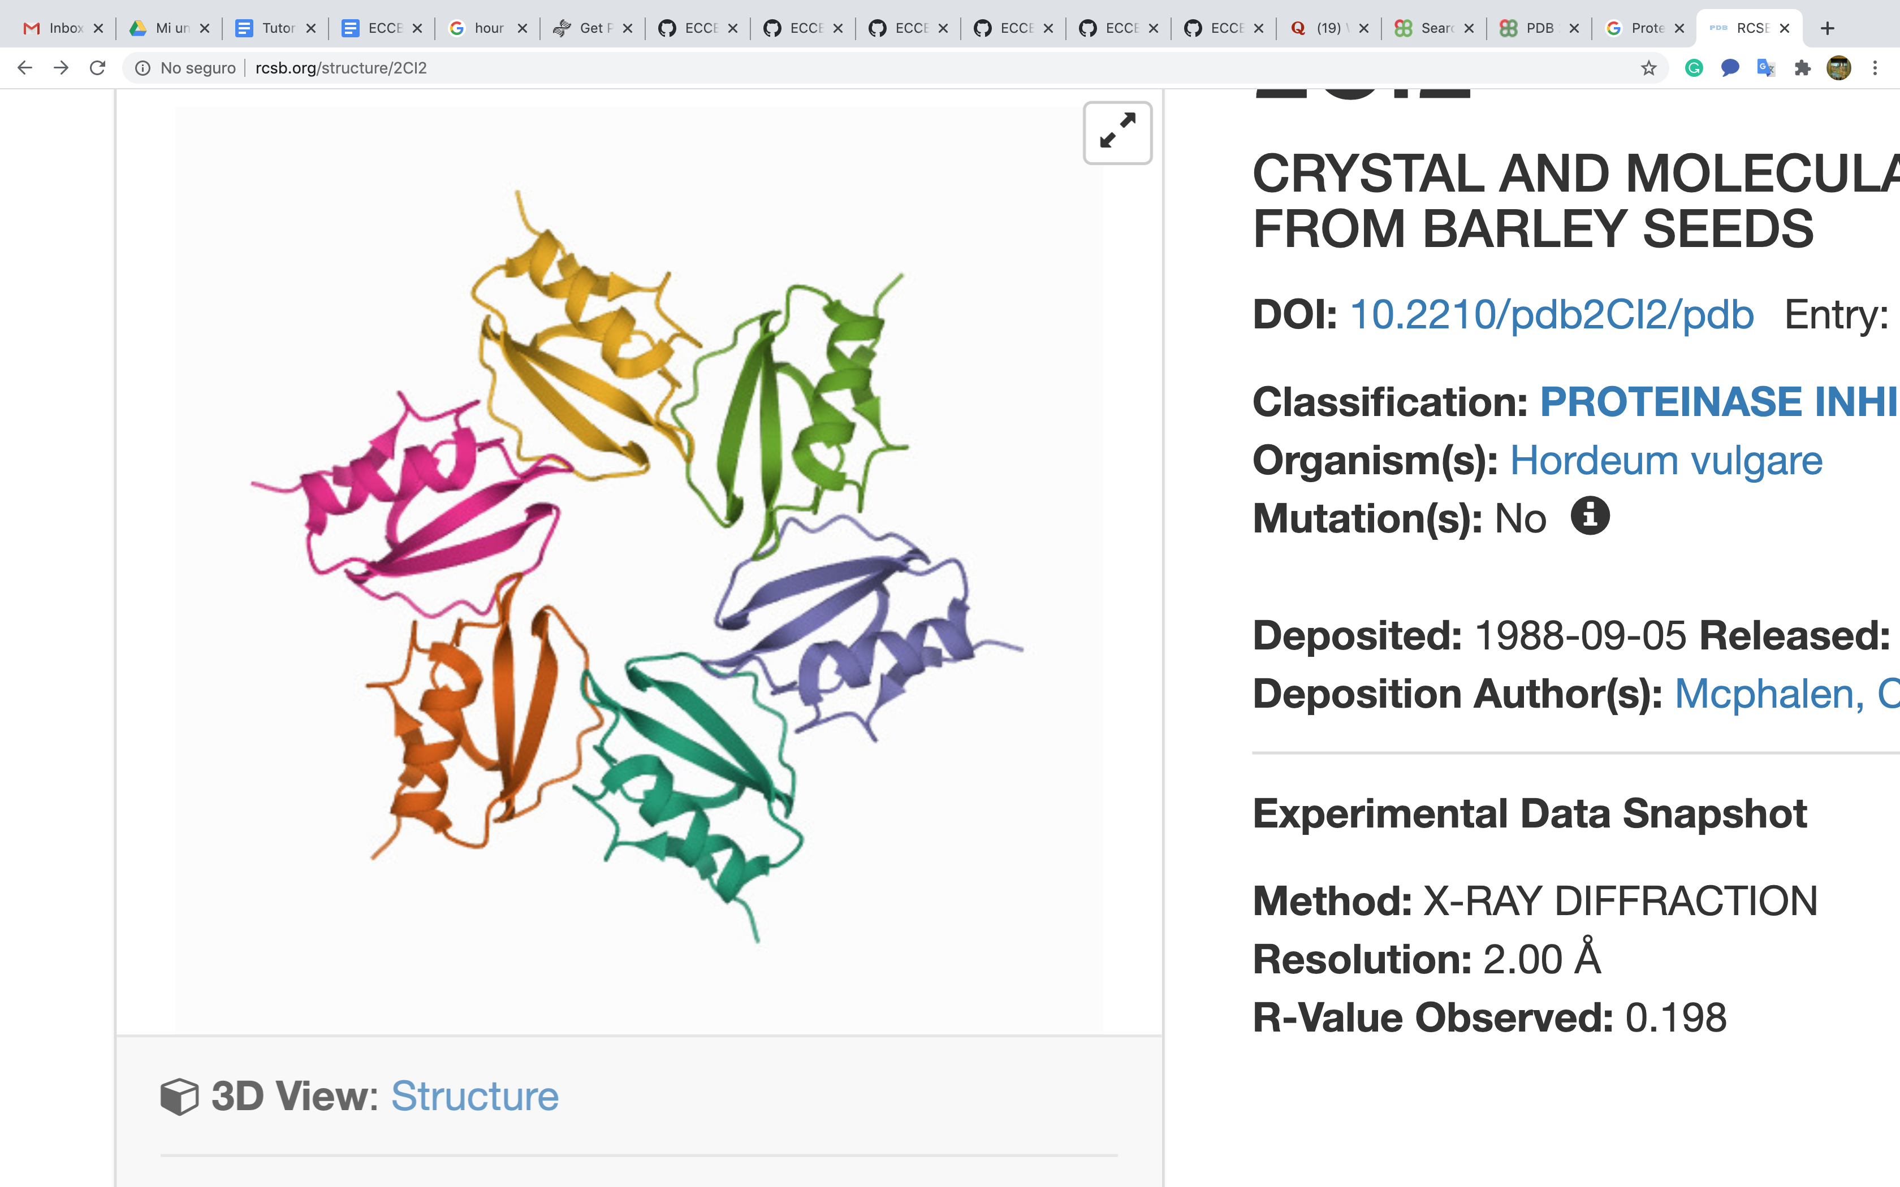
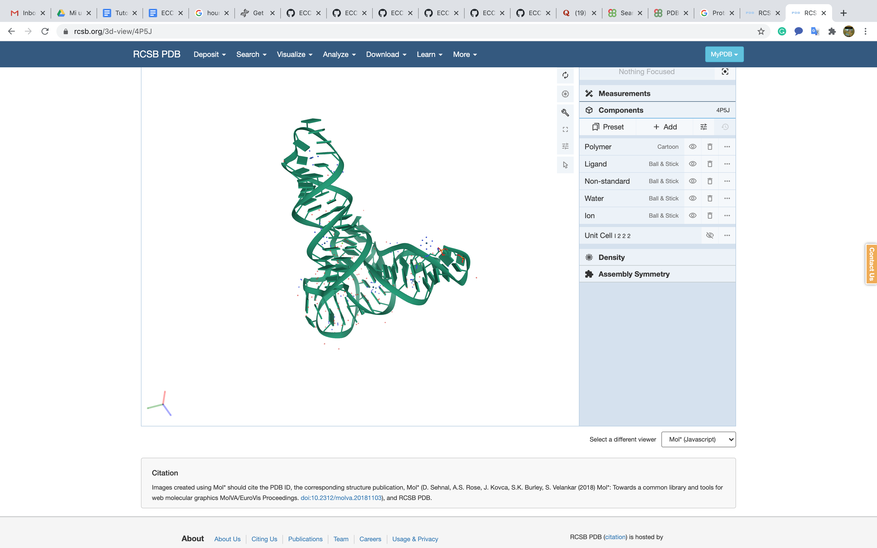
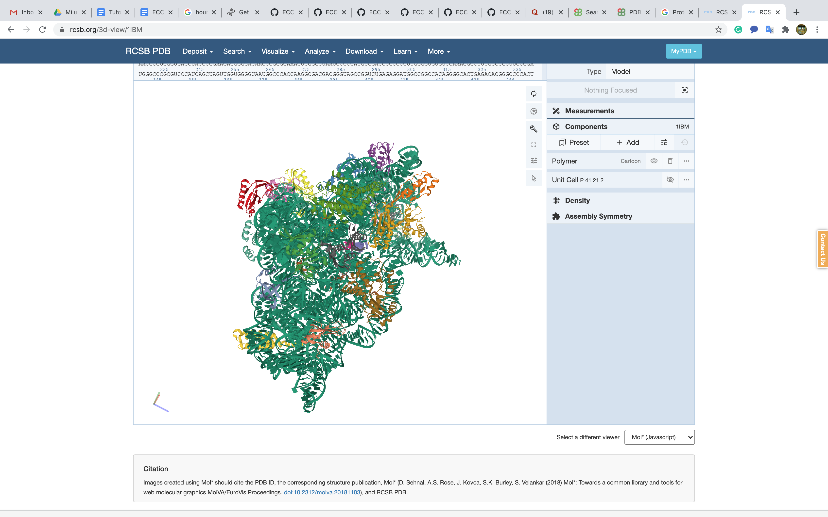
Introduction to data file formats: PDB and mmCIF
The primary information stored in the PDB archive consists of coordinate files that list the atoms in each structure and their 3D location in space.
Berman H, Westbrook J, Feng Z, Gilliland T, Bhat T, Weissig H, Shindyalov I, Bourne P. The Protein Data Bank. Nucleic Acids Research. 2000. 28: 235-242. doi:10.1093/nar/28.1.235
Proteins
Nucleic acids (NA)
Complexes of Protein and NA

Slide 9
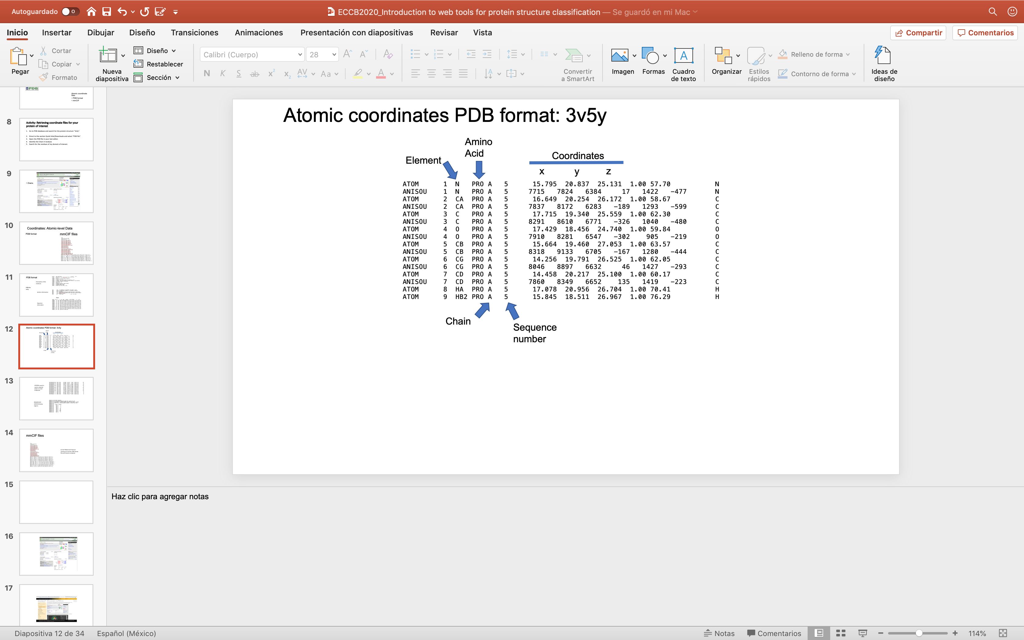
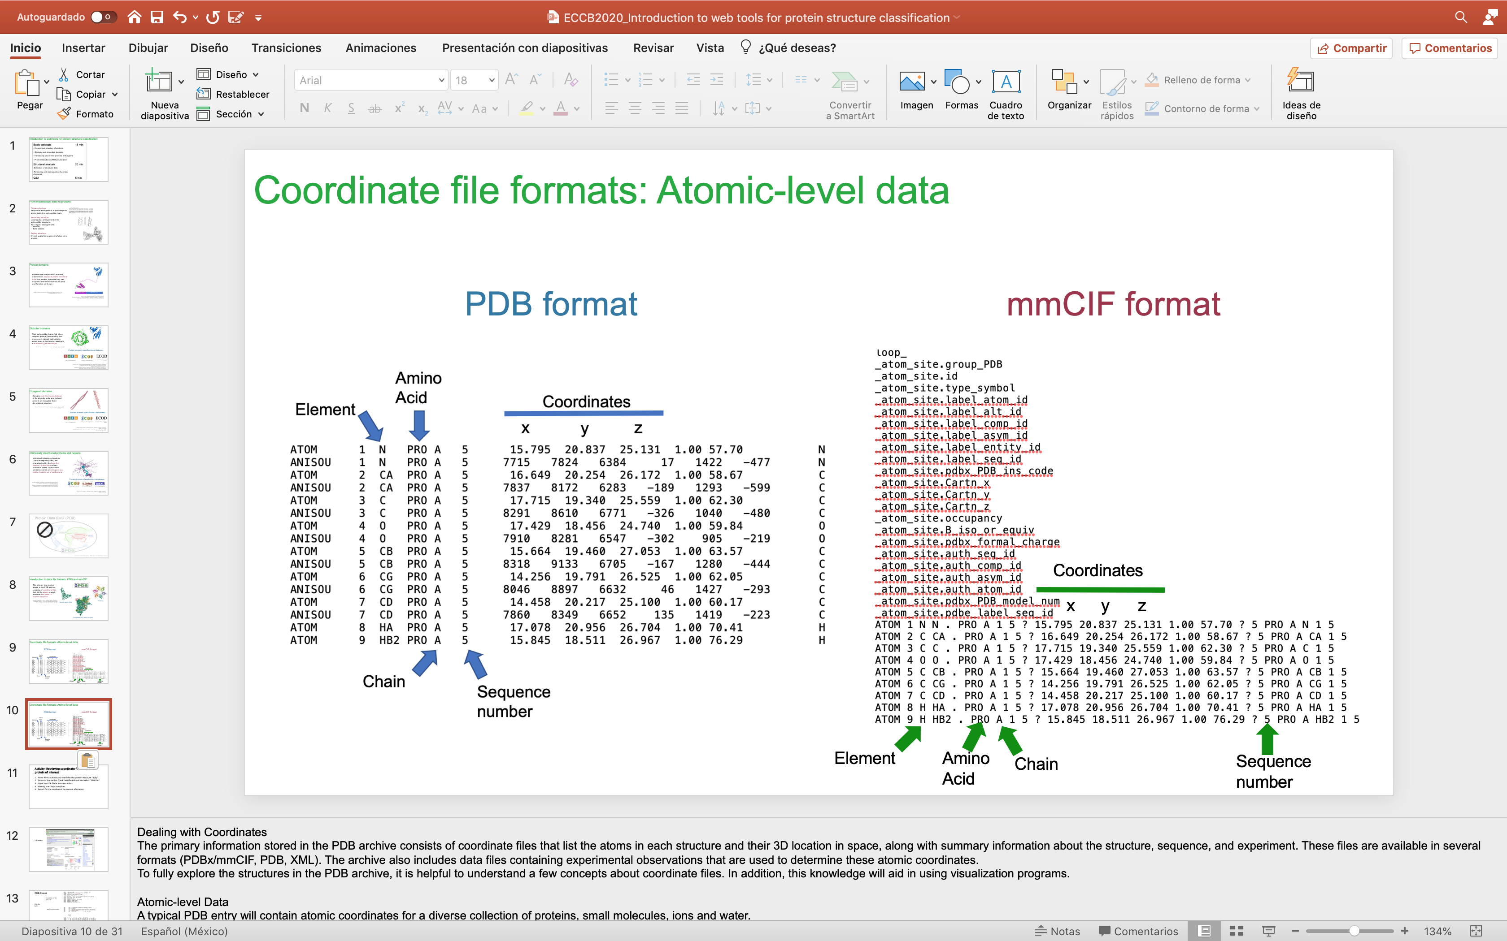
Coordinate file formats: Atomic-level data
PDB format
mmCIF format
Berman H, Westbrook J, Feng Z, Gilliland T, Bhat T, Weissig H, Shindyalov I, Bourne P. The Protein Data Bank. Nucleic Acids Research. 2000. 28: 235-242. doi:10.1093/nar/28.1.235

Slide 10
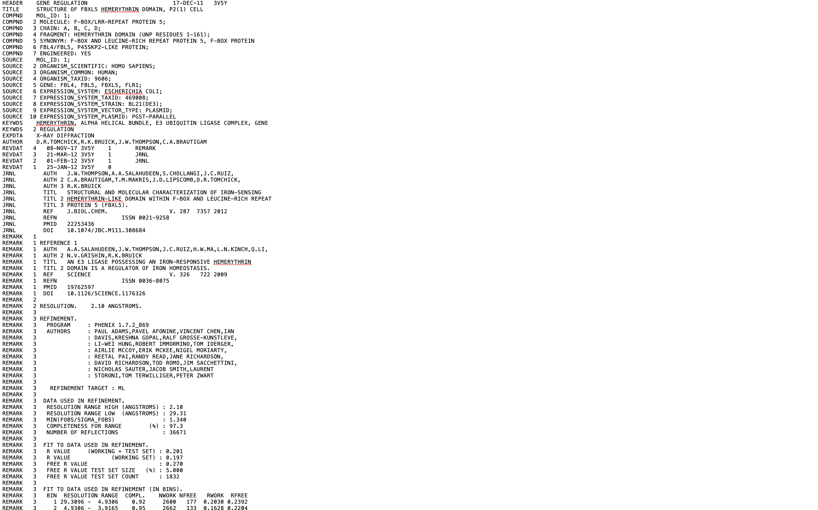
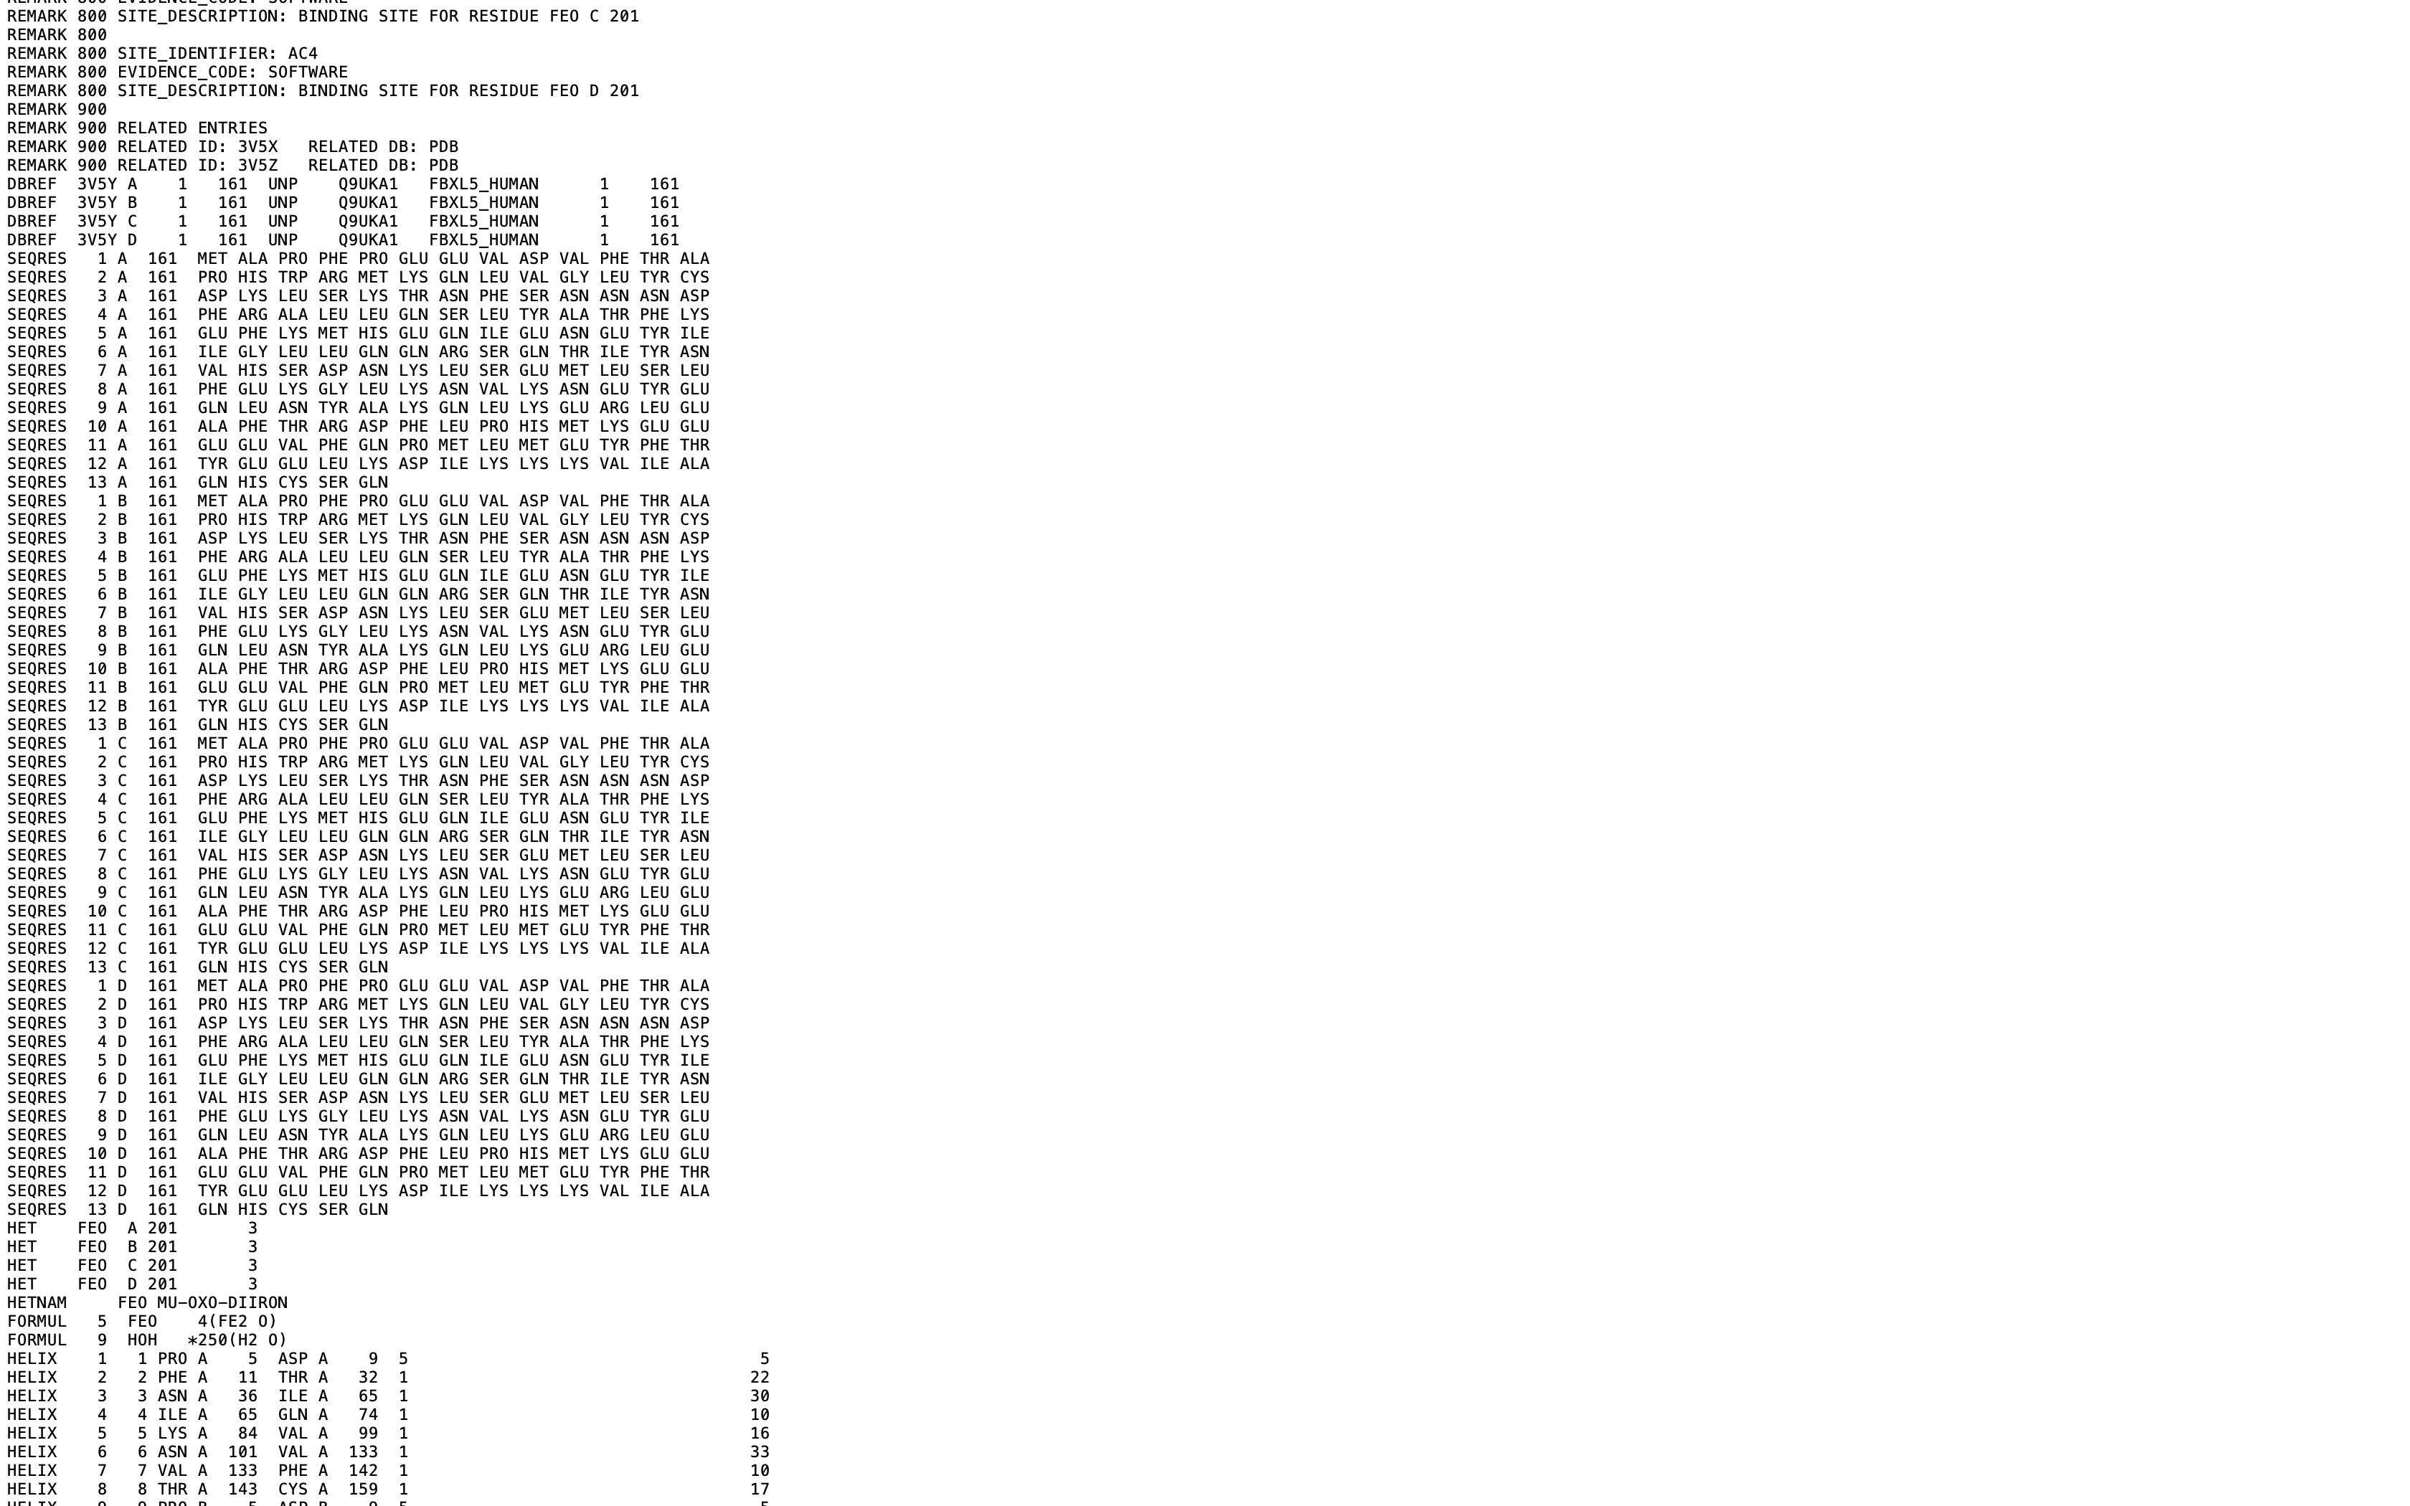
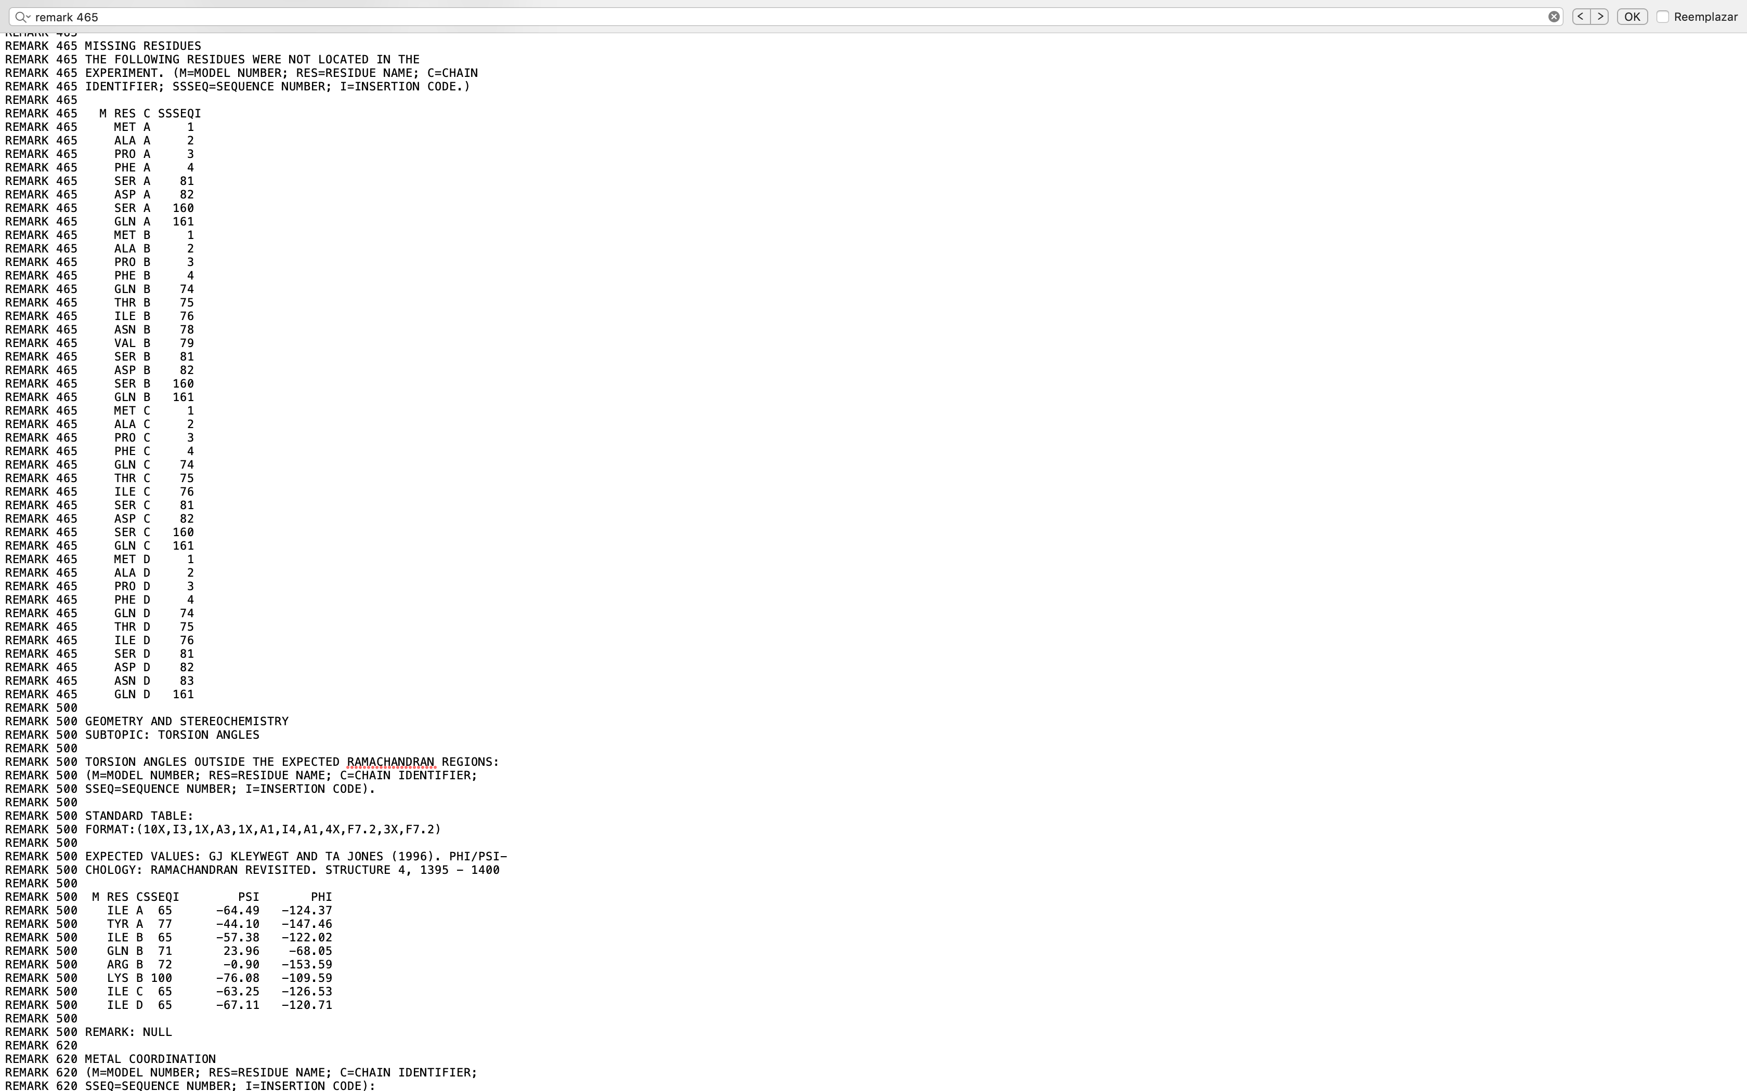
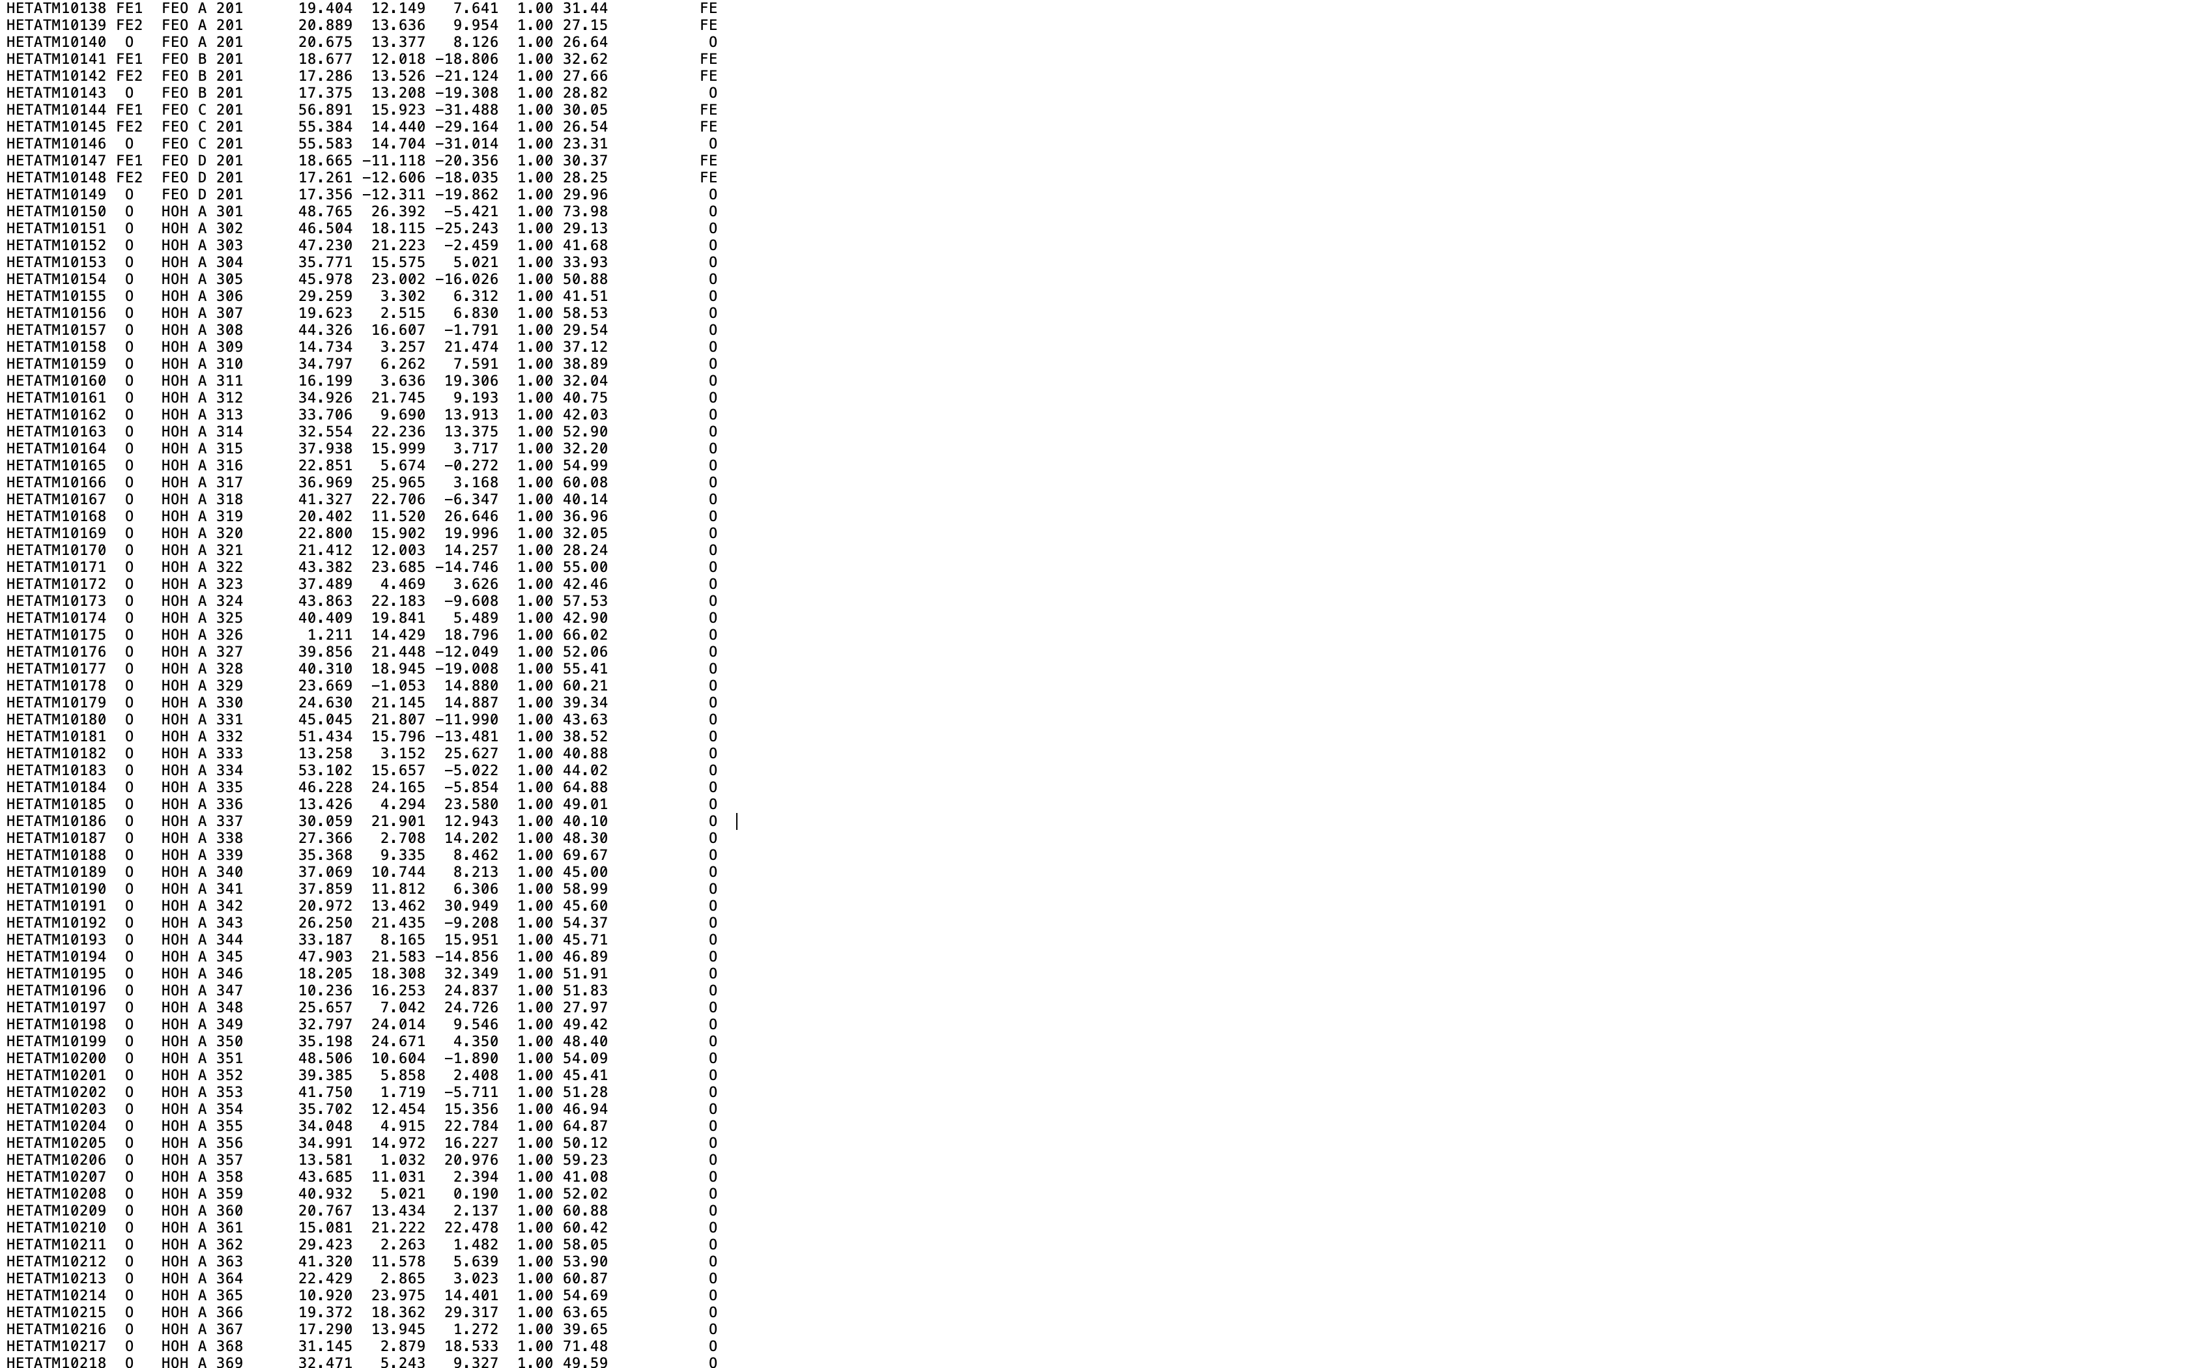
PDB format
Description of the molecule
Authors information
Sequence information (SEQRES). Sometimes some coordinate ATOM records are absent from SEQRES, those are missing residues. Ther are recorded in the REMARK 465 section.
HETATM record is used to identify atoms in small molecules
PDB ID: 3v5y. Structure of FBXL5 hemerythrin domain. Thompson, J.W., Salahudeen, A.A., Chollangi, S., Ruiz, J.C., Brautigam, C.A., Makris, T.M., Lipscomb, J.D., Tomchick, D.R., Bruick, R.K.
J Biol Chem. 2012. 287: 7357-7365. doi: DOI: 10.1074/jbc.M111.308684

Slide 11
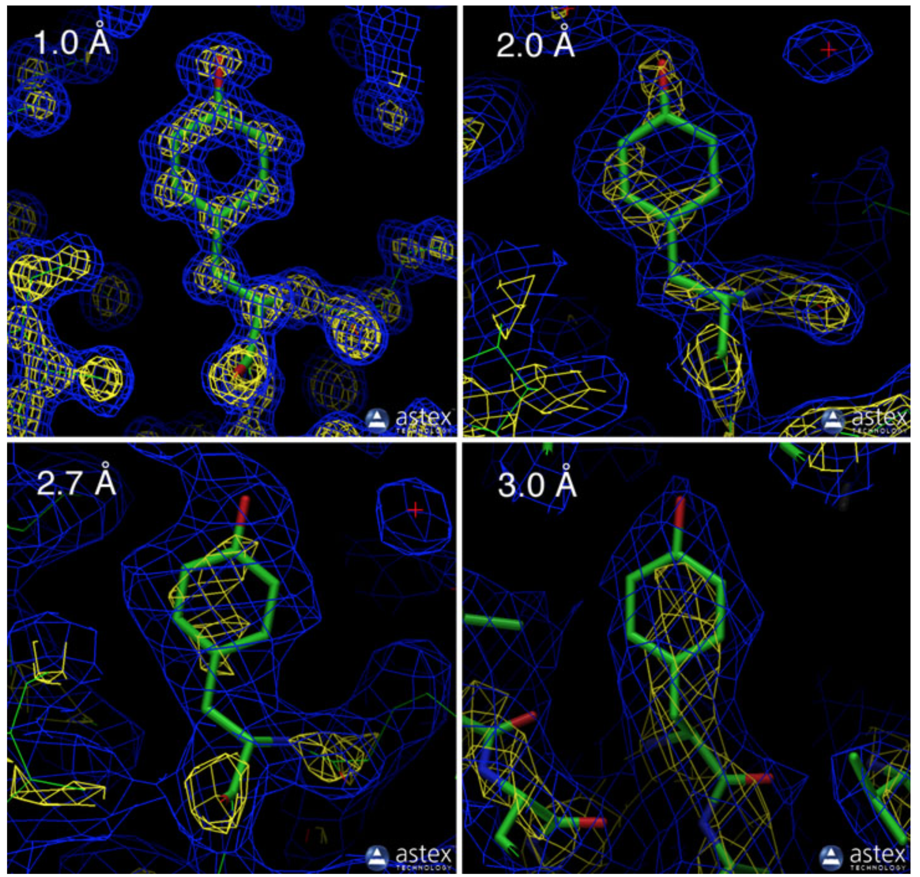
Overall quality of the structure: Resolution
Resolution is a measure of the quality of the data.
High-resolution structures, with resolution values of 1 Å or so, are highly ordered and it is easy to see every atom in the electron density map.
High = 1.0 - 1.8 A
Medium = 1.8 - 3.0 A
Low = > 3.0 A
Note: Not all parts of the structure are at the same resolution.
Berman H, Westbrook J, Feng Z, Gilliland T, Bhat T, Weissig H, Shindyalov I, Bourne P. The Protein Data Bank. Nucleic Acids Research. 2000. 28: 235-242. doi:10.1093/nar/28.1.235

Slide 12
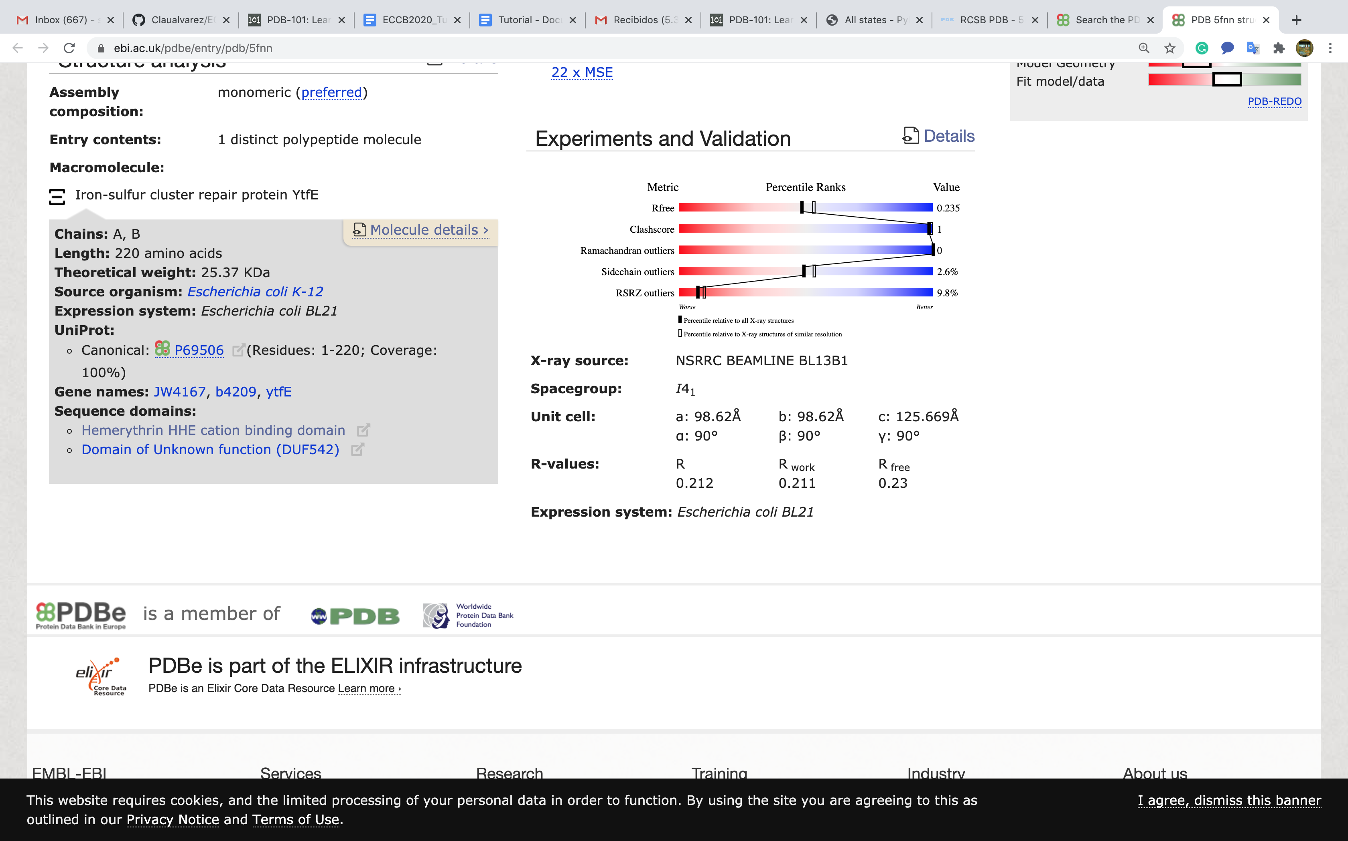
Additional quality parameters: Validation reports
How well a simulated diffraction pattern matches the experimental one?
Number of atoms unusually too-close to each other
Unusual bond angles of the polymer residues
Percentage of residues with an unusual backbone conformation
Fraction of residues that do not fit the electron density
For an ideal model that is not over-interpreting the data, the R-free will be similar to the R-value. Typically, it is a little higher, with a value of about 0.26.
Berman H, Westbrook J, Feng Z, Gilliland T, Bhat T, Weissig H, Shindyalov I, Bourne P. The Protein Data Bank. Nucleic Acids Research. 2000. 28: 235-242. doi:10.1093/nar/28.1.235

